Slide 1

Project Management
Project Communication Management

Slide 2
Learning Objectives
Understand the importance of good communications in projects.
Explain the elements of project communications planning, including how to create a communications management plan and perform a stakeholder communications analysis.
Describe various methods for distributing project information and the advantages and disadvantages of each, discuss the importance of addressing individual communication needs, and calculate the number of communication channels in a project.

Slide 3

What is Project Communication

Slide 4

A Classic Case of Miscommunication
In Center Harbor, when Walter Cronkite steered his boat into port. The avid sailor was amused to see in the distance a small crowd on shore waving their arms to greet him. He could barely make out their excited shouts: “Hello Walter, Hello Walter!”

Slide 5

A Classic Case of Miscommunication
As his boat came closer, the crowd grew larger, still yelling. Pleased at the reception, Cronkite tipped his white captain's hat, waved back, even took a bow. But before reaching dockside, Cronkite's boat abruptly jammed aground. The crowd stood silent. The veteran suddenly realized what they'd been shouting: “Low water, low water!”

Slide 6
Analysis of Flawed Communication Process

Slide 7
Analysis of Flawed Communication Process
Sender has idea
Warn boater

Slide 8
Analysis of Flawed Communication Process
Sender has idea
Warn boater
Sender encodes message
“Low water!”

Slide 9
Analysis of Flawed Communication Process
Sender has idea
Warn boater
Sender encodes message
“Low water!”
Channel carries message
Message distorted

Slide 10
Analysis of Flawed Communication Process
Sender has idea
Warn boater
Sender encodes message
“Low water!”
Channel carries message
Message distorted
Receiver decodes message
“Hello Walter!”

Slide 11
Barriers That Caused Cronkite Miscommunication
Frame of reference
Receiver accustomed to acclaim and appreciative crowds.
Accent makes "water" and "Walter" sound similar.
Receiver more accustomed to speaking than to listening.
Language skills
Listening skills

Slide 12
Barriers That Caused Cronkite Miscommunication
Emotional interference
Ego prompted receiver to believe crowd was responding to his celebrity status.
Physical barriers
Noise from boat, distance between senders and receivers.
Which of these barriers could be overcome through
improved communication skills?

Slide 13
Another Example of Miscommunication

Slide 14
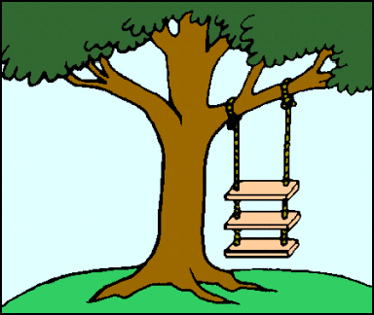
As Marketing Requested It

Slide 15
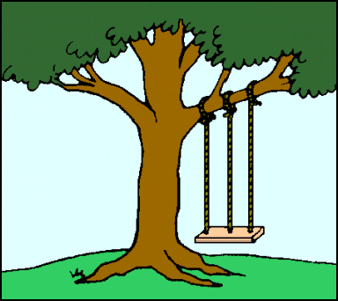
As Sales Ordered It

Slide 16
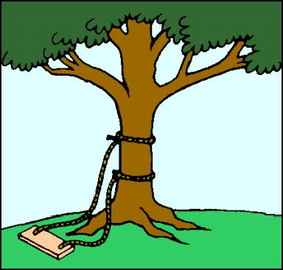
As Engineering Designed It

Slide 17
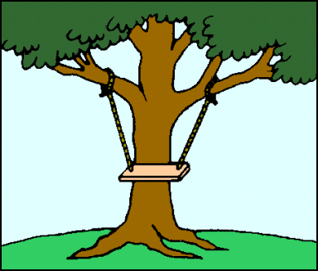
As Production Manufactured It

Slide 18
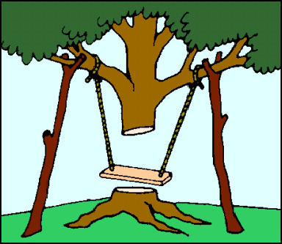
As Maintenance Installed It

Slide 19
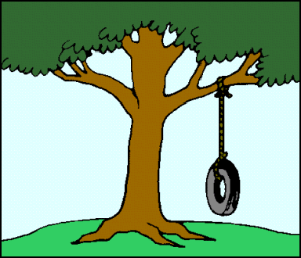
What the Customer Wanted

Slide 20
What is Project communication?
Writing that addresses a particular need
User-oriented documents
Efficient documents
Communication with an electronic and a human component
Communication that reaches a global audience

Slide 21
How is Project Communication defined?
Producing project communication involves creating, designing, and transmitting technical information so that people can understand it easily and use it safely, effectively, and efficiently. Markel, 2001, p. 4

Slide 22
How is Technical Communication defined?
Technical communication is the process by which researchers and technical experts develop information products for users. Killingsworth & Palmer, 1999, p. 4

Slide 23
How is Technical Writing defined?
Technical writing informs, explains, instructs, or persuades a specific audience through mastery of specific strategies and sometimes a special language, so that readers gain new knowledge or the ability to perform their own complex and specialized jobs more effectively. VanAlstyne & Tritt, 2002, p. 6

Slide 24
Who are Technical Communicators?
Technical writer
Technical editor
Web designer
Online documentation specialist
Information developer
Instructional developer

Slide 25
What Skills does a Technical Communicator need?
Address particular readers
Help readers solve problems
Reflect an organization’s goals culture
Work collaboratively
Use design to increase readability
Use words or graphics or both
Use high-tech tools
Meet deadlines

Slide 26
What are Measures of Excellence in Technical Communication?
Honesty
Clarity
Accuracy
Comprehensiveness
Accessibility
Conciseness
Professional appearance
Correctness
Relevance

Slide 27

What are Seven Principles of Technical Writing?
Know your purpose
Know your audience
Choose and organize your content around your audience
Write clearly and precisely
Use good page design
Think visually
Write ethically

Slide 28
What are Types of Technical Communication?
Manuals
Procedures
Instructions
Online help
Reports
Proposals
Memos
Email
Web pages
Quick reference cards

Slide 29

Techniques to Improve Org Communication
Emphasis on teamwork
Improve reporting system
Focus on employees participation & involvement
Improve management system
Change the organizational culture.
Flatter hierarchy.
Cross functional teams.
Fewer control.

Slide 30

Guidelines for Choosing Communication Technologies.
Audience expectations.
Time and cost.
Nature of the message.
Presentation needs.
Work environment.

Slide 31


What is Project Communication
Exchange of Project-specific information

Slide 32
Project Communication Management
Project Communications Management includes the processes required to ensure timely appropriate generation, collection, distribution, storage, retrieval and ultimate disposition of project information. The
Project Communications Management processes provide the critical
links
among people and
information that are
necessary for successful
communications.

Slide 33
What’s in it for a Project Manager?
Three reasons you need to manage project Communication
Meet the information needs of your project stakeholders (Communications Planning and Managing)
Track and report on project performance (Monitoring
Communications)
Formally document project results (Administrative Closure)

Slide 34

Project Communication Management
Plan Communications
Management
Manage Communication
Executing
Processes
Initiating Processes
Planning Processes
View Project Communication in the context of the five PM process groups.
Administrative Closure
Controlling Processes
Monitor Communications
Closing
Processes

Slide 35
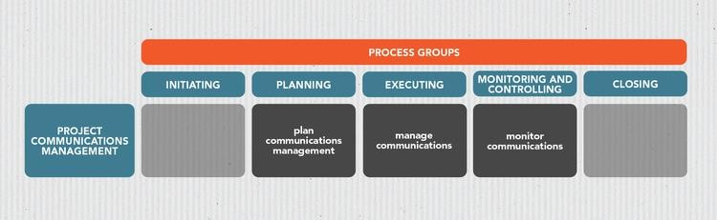

Slide 36
Importance of Good Communications
The greatest threat to many projects is a failure to communicate.
Our culture does not portray IT professionals as being good communicators.
Research shows that IT professionals must be able to communicate effectively to succeed in their positions.
Strong verbal skills are a key factor in career advancement for IT professionals.

Slide 37
Project Communications Management Processes
Plan Communications Management: the process of developing an approach and plan for all project-based communication activities based on the information needs of each stakeholder, available resources in the organization, and the needs of a project.
Manage Communications : the process of creating, collecting, distributing, storing, accessing, managing, monitoring, and disposing of project information.
Monitor Communications: the process of ensuring that the information needs of project stakeholders, as well as the project, are met.

Slide 38
Generally, a project management communication plan should answer the following key questions:
Who? Who needs to know?
What? What do they need to know?
When? How frequently?
Where? Where are communications required?
Why? Why is this important?
How? How are they kept informed?

Slide 39
Who? Stakeholder Identification
Did you think of everyone?
If you are designing an application in this project, have you included the end-users in the early project communications?
If your end-user works for another organization such as a local or city government or a voluntary agency, have you also kept the IT people in those entities
informed?

Slide 40
What? Stakeholder Analysis
Tendency to send too much to too many – very easy to do with electronic communications! Too much is as bad as too little – can’t read everything.
Target your audiences – and realize you may have more than one.

Slide 41
When ?
How often?
Morning & afternoon?
Day of week?
Day of month?
Different intervals for various stakeholders
Weekly for team members
Bi-weekly for sponsor
Monthly for Executives
Etc.

Slide 42
Where ?
Location for status meetings
Location for team meetings
Locations for information: Network drive, website, internal or external, Email attachments, Email text

Slide 43
Why ?
Curiosity? Good/bad
Need to know?
Provide information
Prepare end-users for transition
MANY REASONS TO SHARE INFORMATION!

Slide 44
How ?
Emails
Status reports
Phone calls
Meetings
Face to face, one on one
Press release
Other?

Slide 45
Plan Communications Management
During the plan communications management process, project managers, together with the project team, develop a project communication plan that details your communication management system or approach.
The group should specify how it intends to address stakeholders’ communication needs throughout the project using assets available within the organization. Different stakeholders have different communication expectations.

Slide 46
Communications Management Plan Contents
The message or information to be communicated
Communication distribution frequency and schedule
Communication modes, such as email, text messages, face-to- face communication, meetings, reports on the status of deliverables and project milestones, etc.
The stakeholders who are receiving the information
The team member(s) responsible for delivering content and responding to questions or requests
Communication constraints
communication, schedule,
(e.g., budget allotted for
communication
technology, requiring
internal and external policies, legislation
communications to be handled a certain way, etc.)

Slide 47
Communications Management Plan Contents (cont’d)
Input documents you will need in order to create your communication plan may include:
A project charter
A stakeholder register
A resource allocation and management plan
Although the project communication plan is created during the project planning phase, you may have to repeat the process as the project’s communication requirements change. If stakeholders are added to or removed from the project, the plan will have to be revisited.

Slide 48
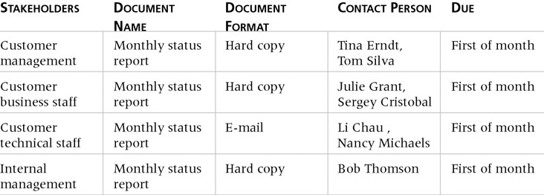
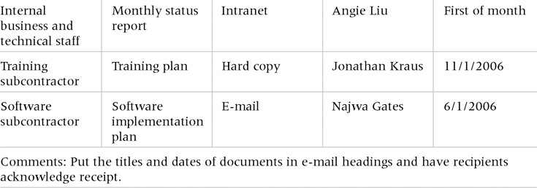
Sample Stakeholder Analysis for Project Communications

Slide 49
Manage Communications
In this process, project managers and their teams execute the tasks and activities defined in the communication plan, i.e., the collection, creation, storage, retrieval, management, distribution, monitoring, and disposal of project information.
The goal is to provide timely, accurate information to the right people using the appropriate project communication tools.

Slide 50
Manage Communications (Cont)
Besides information distribution, this is also where you encourage stakeholders to ask questions or discuss any lingering doubts or confusion they may have regarding the project, so you can provide clarification.
Communication is a two-way street. Not only should you provide the information to the right recipients at the right time, but you also have to make certain they receive and understand the information you send out.

Slide 51
Manage Communications (Cont)
Documents created during this process include:
Performance reports
Presentations
Schedule updates
Updates on the status of the project’s deliverables
Certain project documents may have to be updated, too, such as the communication management plan, project plan, stakeholder register, stakeholder engagement plan, and the lessons learned register.
Communications management occurs throughout the project’s life cycle.

Slide 52
Manage Communications (Cont)
Getting the right information to the right people at the right time and in a useful format is just as important as developing the information in the first place.
Important considerations include:
Using technology to enhance information distribution.
Formal and informal methods for distributing information.

Slide 53
Distributing Information in an Effective and Timely Manner
Don’t bury crucial information.
Don’t be afraid to report bad information.
Oral communication via meetings and informal talks helps bring important information—good and bad—out into the open.

Slide 54
Importance of Face-to-Face Communication
Research says that in a face-to-face interaction:
58 percent of communication is through body language.
35 percent of communication is through how the words are said.
7 percent of communication is through the content or
words that are spoken.
Pay attention to more than just the actual words someone is saying.
A person’s tone of voice and body language say a lot
about how he or she really feels.

Slide 55
Encouraging More Face-to-Face Interactions
Short, frequent meetings are often very effective in projects.
Stand-up meetings force people to focus on what they really need to communicate.
Some companies have policies preventing the use of e- mail between certain hours or even entire days of the week.

Slide 56
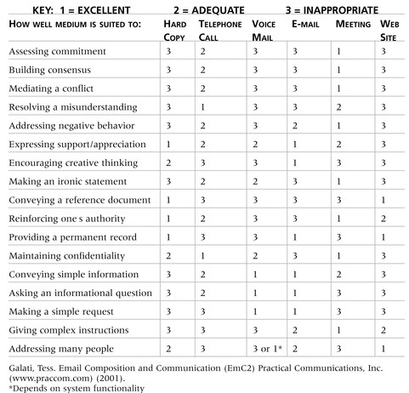
Media Choice Table

Slide 57
Understanding Group and Individual Communication Needs
People are not interchangeable parts.
As illustrated in Brooks’ book The Mythical Man-Month, you cannot assume that a task originally scheduled to
take two months of one person’s time can be done in one
month by two people.

Slide 58
Personal Preferences Affect Communication Needs
Introverts like more private communications, while extroverts like to discuss things in public.
Intuitive people like to understand the big picture, while sensing people need step-by-step details.
Thinkers want to know the logic behind decisions, while feeling people want to know how something affects them personally.
Judging people are driven to meet deadlines while perceiving people need more help in developing and following plans.

Slide 59
Other Communication Considerations
Rarely does the receiver interpret a message exactly as the sender intended.
Geographic location and cultural background affect the complexity of project communications.
Different working hours
Language barriers
Different cultural norms

Slide 60
Determining the Number of Communications Channels
As the number of people involved increases, the complexity of communications increases because there are more communications channels or pathways through which people can communicate.
Number of communications channels = n(n-1)
2
where n is the number of people involved.

Slide 61
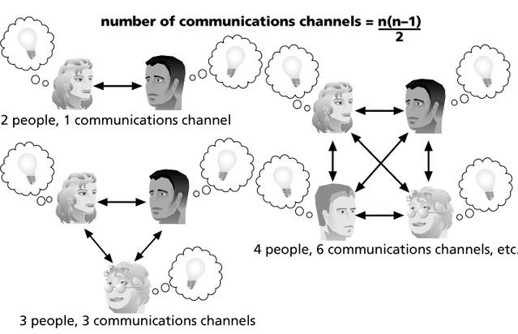
The Impact of the Number of People on Communications Channels

Slide 62
Monitor Communications
Also performed throughout the project, this process ensures that all of the communication techniques and methods you’re using -- including the monitoring and control measures you have in place -- follow the project communication plan.
It’s also at this stage that you gauge whether or not your approaches are producing the desired results. Otherwise, you may have to make some adjustments in order to prevent any communication issues from affecting the project.

Slide 63
Monitor Communications (Cont)
Actions to carry out in this process include:
Verify that communications go out as scheduled.
Verify that the right stakeholders receive the right communications.
Verify that stakeholders understand the communications they receive.
Verify that relevant feedback or questions reach the right people.

Slide 64
Monitor Communications (Cont)
Some of the project management documents you'll be creating or updating include:
Change requests
Work performance reports
Communication management and stakeholder engagement plans
Other relevant project documents, such as the issue log and the stakeholder register

Slide 65
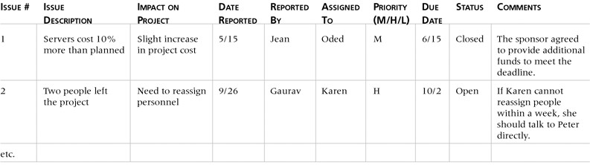
Issue Log

Slide 66
How to be Successful at Project Communication Management
From project initiation to closing, effective communication drives project management. Creating a project proposal that will compel investors to act favorably requires excellent communication skills. The same is true for:
Negotiating contracts with vendors and suppliers
Gathering the project’s requirements
Interviewing stakeholders to understand their needs and expectations
Planning the project
Dividing the project into work packages
Assigning tasks and responsibilities to team members
Building a winning team
Facilitating meetings
Keeping track of the project’s progress
Writing reports

Slide 67
How to be Successful at Project Communication Management
And then there’s diversity in the workplace. Many of today’s project teams are composed of diverse groups of people.
Even among small, local teams, communication challenges abound. You want everyone on the same page. You want people with an interest in the project to know what’s going on -- not just once, but on a regular basis.
You want everyone involved to understand the project’s priorities, as well as the risks and opportunities it presents.
You want team members to feel accountable for their assigned roles and responsibilities -- and to rally toward the same objectives. You want stakeholders to support, instead of oppose, the project’s goals.
If opposition from stakeholders cannot be helped, though, you'll want to be able to manage their influence on the project. At the same time, you have to be respectful, receptive, and encouraging.

Slide 68
Key Skills for Project Communication Management
Showing active listening skills
Having strong speaking and writing skills
Being skilled at conflict resolution
Ability to motivate, engage, and guide a team
Setting expectations, and managing them
Having a propensity for questioning ideas and exploring alternatives
Recognizing that people think and communicate differently
The ability to create an environment of trust, so people can comfortably speak their minds
Acknowledging opposing ideas (even when you don’t agree with them)
Being willing to ask for and accept help if you need it
Having a positive disposition

Slide 69
Overcoming Communication Barriers
Realize that communication is imperfect.
Adapt the message to the receiver.
Improve your language and listening skills.
Question your preconceptions.
Plan for feedback.

Slide 70
Surmounting Organizational Barriers
Encourage open environment for interaction and feedback.
Flatten the organizational structure.
Promote horizontal communication.
Provide hotline for anonymous feedback.
Provide sufficient information through formal channels.

Slide 71
Barriers to Interpersonal Communication
Bypassing
Limited frame of reference
Lack of language skills
Lack of listening skills
Emotional interference
Physical distractions

Slide 72
Understanding is shaped by
Communication climate
Context and setting
Background, experiences
Knowledge, mood
Values, beliefs, culture

Slide 73
Barriers That Block the Flow of Information in Organizations
Closed communication climate
Top-heavy organizational structure
Long lines of communication
Lack of trust between management and employees
Competition for power, status, rewards

Slide 74
Additional Communication Barriers
Fear of reprisal for honest communication
Differing frames of reference among communicators
Lack of communication skills
Ego involvement
Turf wars

Slide 75
Benefits of Effective Communication
Improves quality of services & products.
Provides competitive advantage.
Motivate & involve emplyees.
Reduce Cost.
Saves Time.
Increases productivity
Streamline work practices.
Build Goodwill.

Slide 76






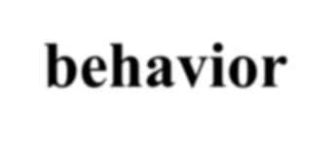




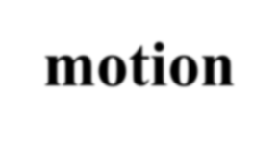
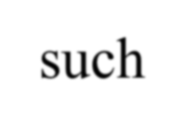


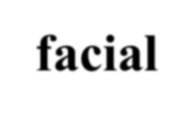


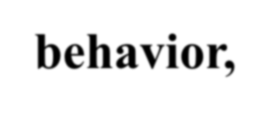
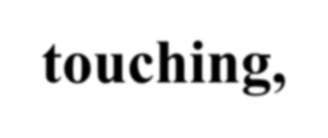

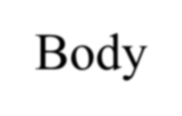
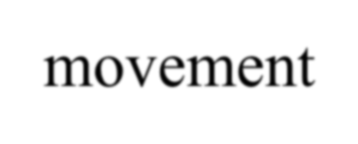



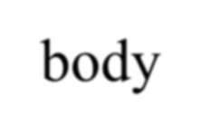
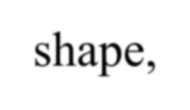
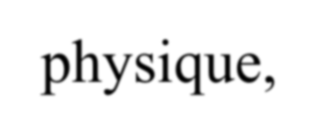

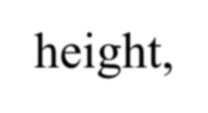
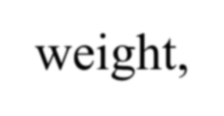
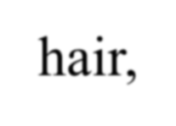

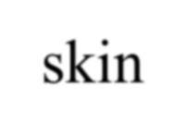

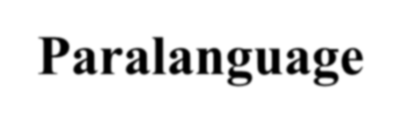

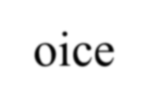
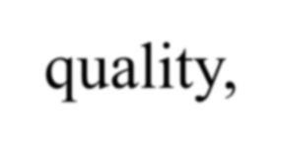
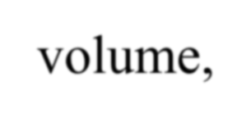

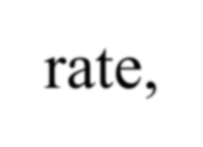
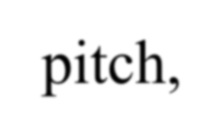

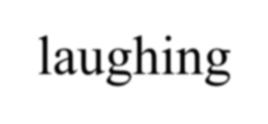

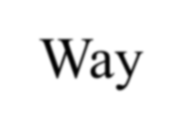
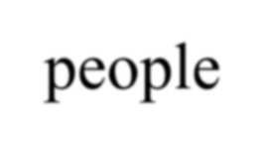
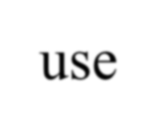
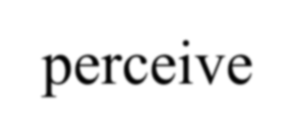
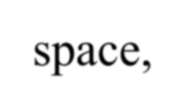
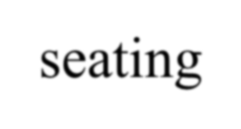
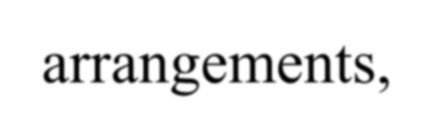
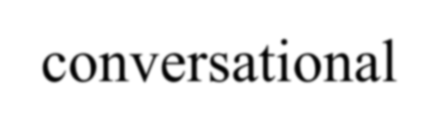
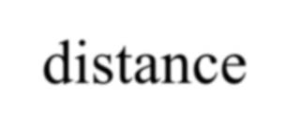
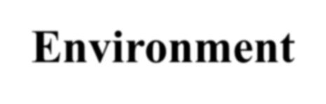

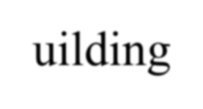

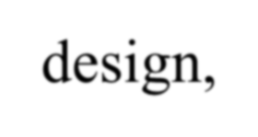
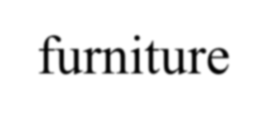
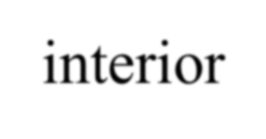
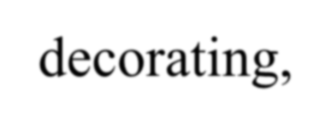
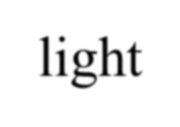















Types of Nonverbal Communication:
Kinesic behavior,-body motion such as gestures, facial
expressions, eye behavior, touching,- Body movement.
Physical characteristics- body shape, physique, posture, height, weight, hair, & skin color.
Paralanguage- Voice quality, volume, speech rate, pitch, & laughing.
Proxemics, -Way people use & perceive space, seating arrangements, & conversational distance.
Environment- Building & room design, furniture & interior decorating, light noise, & cleanliness.
Time-Being late or early, keeping others waiting, & other relationships between time & status.

Slide 77
Reading Body Language
Unspoken message | Behavior
“I want to be helpful.” |  | Uncrossing legs
 |  | Unbuttoning coat or jacket
 |  | Unclasping hands
 |  | Moving closer to other person
 |  | Smiling face
 |  | Removing hands from pockets
 |  | Unfolding arms from across chest
“I’m confident” |  | Avoiding hand-to-face gestures & head scratching
 |  | Maintaining an erect stance
 |  | Keeping steady eye contact
 |  | Steeling fingertips below chin

Slide 78
Reading Body Language
Unspoken message | Behavior
“ I’m nervous |  | Clearing throat
 |  | Expelling air (such as “Whew!”)
 |  | Placing hand over mouth while speaking
 |  | Hurried cigarette smoking
“I’m superior to you.” |  | Peering over tops of eyeglasses
 |  | Pointing a finger
 |  | Standing behind a desk & leaning palms down on it
 |  | Holding jacket leaps while speaking

Slide 79
Thank you

